Slide 1
LogiFlow – Smart Logistics & Delivery Management System
Team Member | Roll Number
Vaishali | 2520030117
Bindhu Madhavi | 2520030077
Nava Harsha Chowdary | 2520030493
Section: 7 | Team: 3
Under the Guidance of Dr. Spandana . S
Department of Computer Science and Engineering
KONERU LAKSHMAIAH EDUCATION FOUNDATION
KLH Deemed to be University

Slide 2
Group Number: 3
K
Konda Vaishali
B
P. Bindhu Madhavi
N
Alaparthi Nava Harsha
2520030117
2520030077
2520030493
Project Team Member
Project Team Member
Project Team Member
Project focus: database system engineering and distributed backend development
Website prototype: LogiFlow Smart Logistics & Delivery Management
Core demonstration areas: delivery operations, database analytics and distributed infrastructure

Slide 3
Abstract
LogiFlow is a web-based smart logistics and delivery management interface for monitoring shipments and delivery operations.
The website provides a centralized dashboard for shipment status, live tracking, route optimization, notifications and delivery history.
Database analytics presents SQL operations, query-performance indicators and an indexing strategy for shipment data.
A distributed-system view demonstrates a primary database, replicas, replication, read scaling and sharding concepts.
The supplied website is implemented as a single HTML page with client-side navigation and demonstration data.

Slide 4
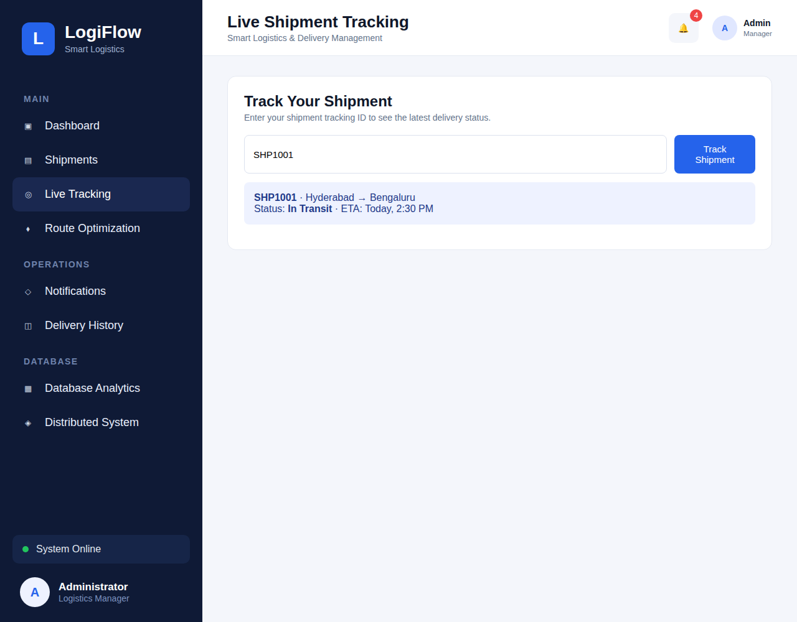
Introduction
Logistics operations require timely visibility into shipment movement, delivery status and exceptions.
LogiFlow provides a dashboard-oriented interface for administrators and logistics managers.
Shipment records include tracking ID, customer, route, package type, status, priority and ETA.
Users can search shipments, track by tracking ID and review operational notifications.
The interface also presents route optimization, database analytics and distributed infrastructure views.
Live Tracking page

Slide 5
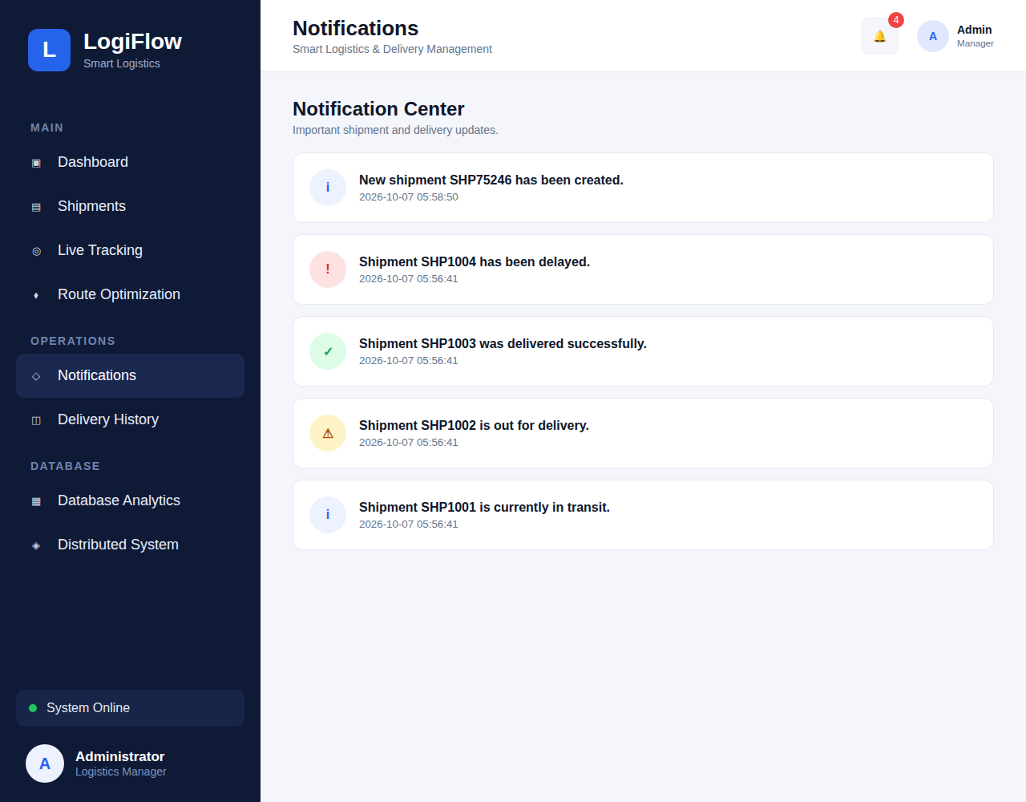
Existing / Current Website
Single-page LogiFlow web interface with a fixed navigation sidebar.
Main sections: Dashboard, Shipments, Live Tracking and Route Optimization.
Operations sections: Notifications and Delivery History.
Database sections: Database Analytics and Distributed System.
Dashboard displays six demonstration shipments with statuses including Picked Up, Delayed, Delivered, Out for Delivery and In Transit.
Notifications page

Slide 6
Problem
Shipment information can be difficult to monitor when operational data is distributed across separate views.
Delayed deliveries require quick identification and attention.
Tracking needs a simple mechanism for locating the latest status of a shipment.
Route planning should consider distance, travel time, fuel cost and delivery delays.
Database performance can affect frequent tracking searches and delivery-history queries.
Distributed logistics systems must consider replication, read scaling and partition tolerance.

Slide 7
Solution (Contribution)
1
Unified Operations Dashboard
2
Shipment Tracking
Centralized view of shipment totals, delivery performance and recent shipment activity.
Search by tracking ID and display route, status and ETA.
3
Route Optimization
4
Database Analytics
Demonstrates distance, estimated travel time and fuel-cost information.
Shows SQL operations, query-performance indicators and indexing strategies.
5
Distributed Infrastructure
6
Operational Notifications
Models primary/replica nodes with replication, read scaling and sharding.
Highlights new shipments, delays, successful deliveries and active transit.

Slide 8
Objectives
To provide a clear dashboard for monitoring shipment activity and delivery performance.
To enable shipment search and tracking using unique tracking IDs.
To support route-planning information such as distance, time and fuel cost.
To maintain a clear history of completed deliveries and operational notifications.
To demonstrate SQL operations, indexing and query-performance concepts.
To visualize distributed data infrastructure using replication, read scaling and sharding.

Slide 9
Modules
1
Dashboard
2
Shipment Management
3
Live Tracking
Shipment statistics, live delivery overview and recent activity.
Shipment table with search by tracking ID, customer or location.
Tracking-ID based shipment lookup with current status and ETA.
4
Route Optimization
5
Operations
6
Database Analytics
Pickup, destination, vehicle, distance, time and fuel cost.
Notifications and delivery history.
SQL operations, query performance and indexing strategy.
7
Distributed System
Primary database, replicas, replication, read scaling and sharding.

Slide 10
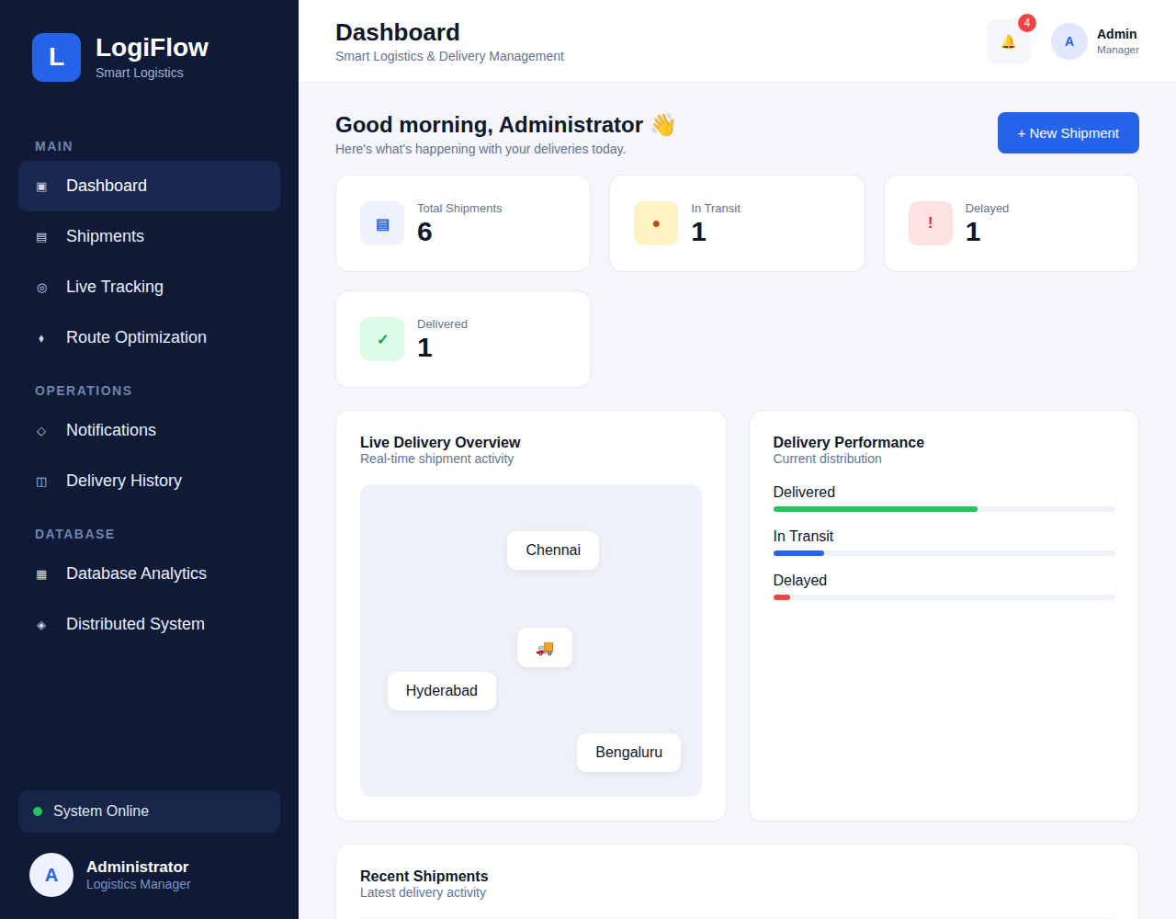
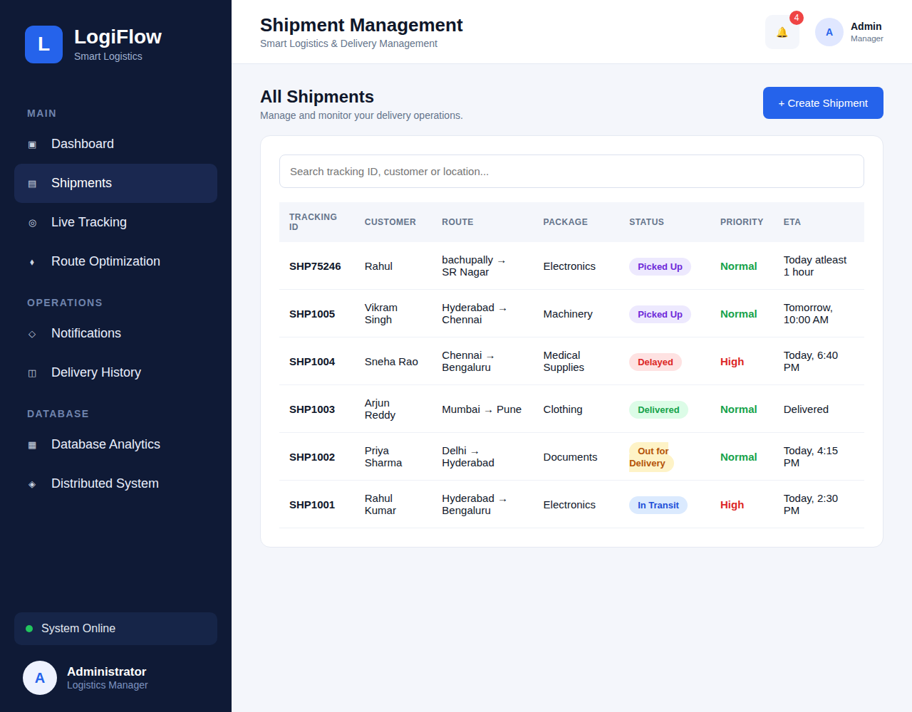
Website Implementation & User Interface
Dashboard
Shipment Management
Website source: Hackathon Website (1).html • Responsive single-page layout • Client-side navigation

Slide 11
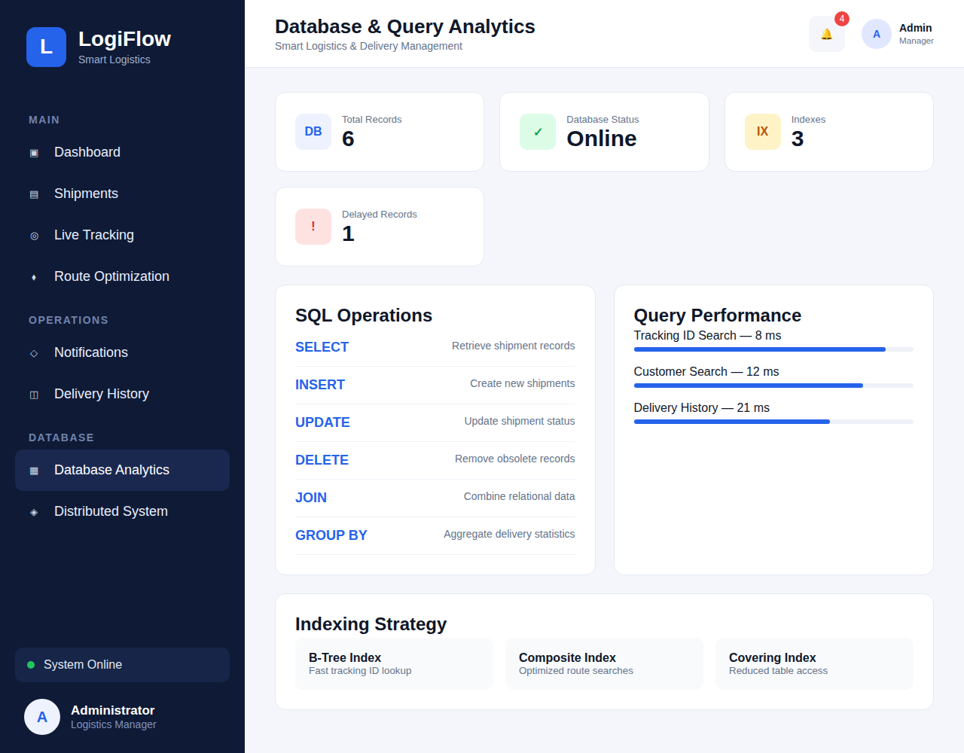
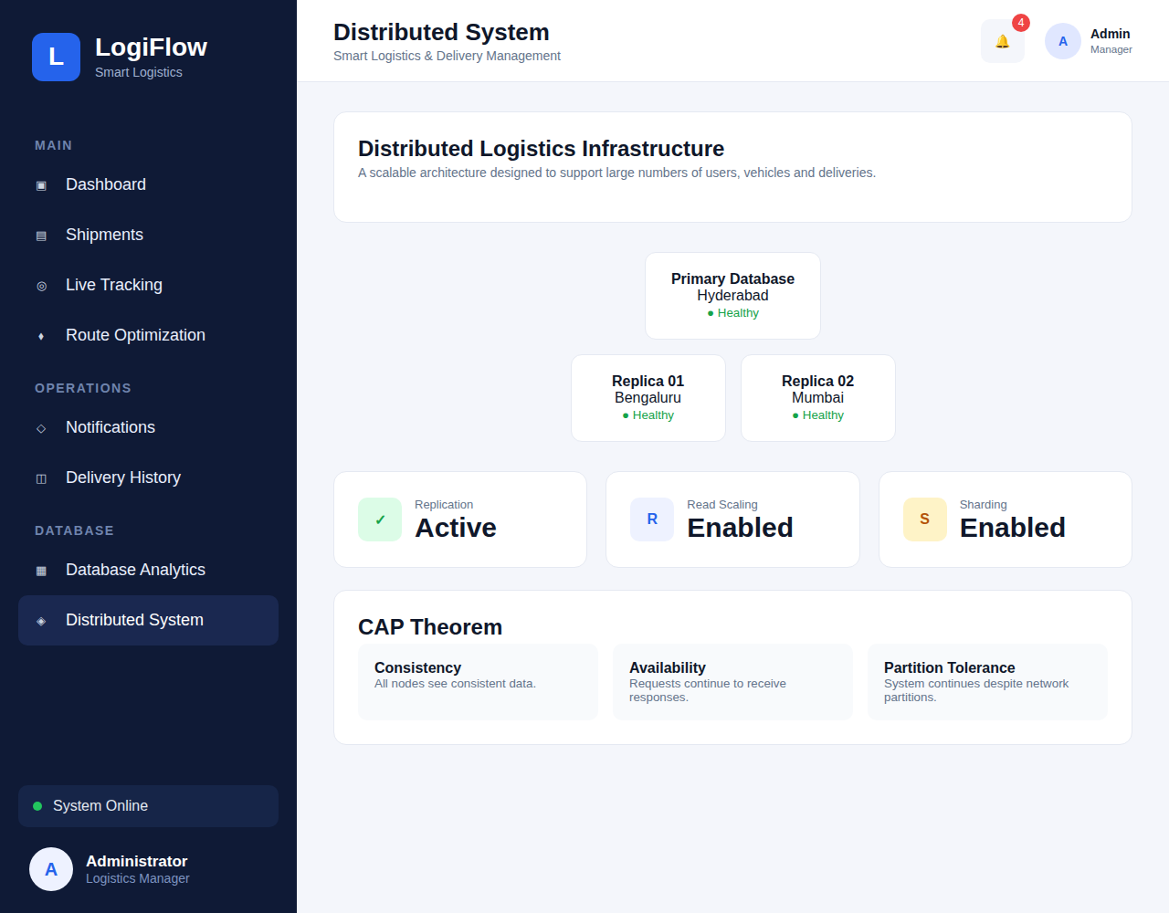
Database & Distributed System
Database Analytics
Distributed System

Slide 12
Software / Technology Requirements
HTML5 and CSS3 for the web interface and responsive layout.
JavaScript for client-side navigation, shipment data rendering, search and tracking interactions.
Browser environment such as Chrome/Edge for running the website.
SQLite / relational database concepts represented through the Database Analytics section.
SQL concepts: SELECT, INSERT, UPDATE, DELETE, JOIN and GROUP BY.
Version control and project development through VS Code and Git/GitHub.
Prototype emphasis: web UI + database/distributed-system demonstration

Slide 13
Conclusion and Future Scope
Conclusion
Future Scope
LogiFlow brings shipment monitoring, tracking, route planning, notifications and delivery history into one web interface.
The database analytics view demonstrates common SQL operations, indexing and query-performance concepts.
The distributed-system view communicates how replicas, replication, read scaling and sharding can support a larger logistics platform.
Connect the interface to a production Flask/REST backend and persistent database.
Add real-time GPS/map integration, authenticated users, role-based administration and live shipment updates.
Add real database execution, monitoring dashboards and cloud deployment for multi-user operation.

Slide 14
THANK YOU
SMART LOGISTICS & DELIVERY TRACKING
LogiFlow Web-Based Logistics Management System

